Slide 1

A GENERATIVE APPROACH FOR FACIAL EXPRESSION DATA AUGMENTATION
Advanced Deep Learning Models and Methods
Azzoni Francesco
Fasana Corrado
Pasini Samuele

Slide 2
TABLE OF CONTENTS
Introduction
CycleGAN
Enhanced CycleGAN (ECycleGAN)
Conducted experiments
Conclusions

Slide 3


INTRODUCTION
Deep Learning (DL) approaches have been widely used in the last years to successfully solve several tasks.
However, these approaches are really data hungry, meaning that they require lots of data to be properly trained and obtain a satisfiable model.
DL architecture
Model

Slide 4
INTRODUCTION
What if data is limited?
Data augmentation techniques could be exploited to complement and complete the data manifold.
The augmented dataset is fed to the DL architecture for training.
DATA
AUGMENTATION
DL architecture
Model

Slide 5
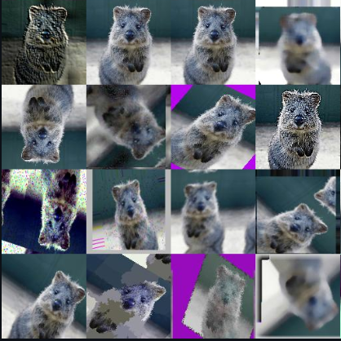
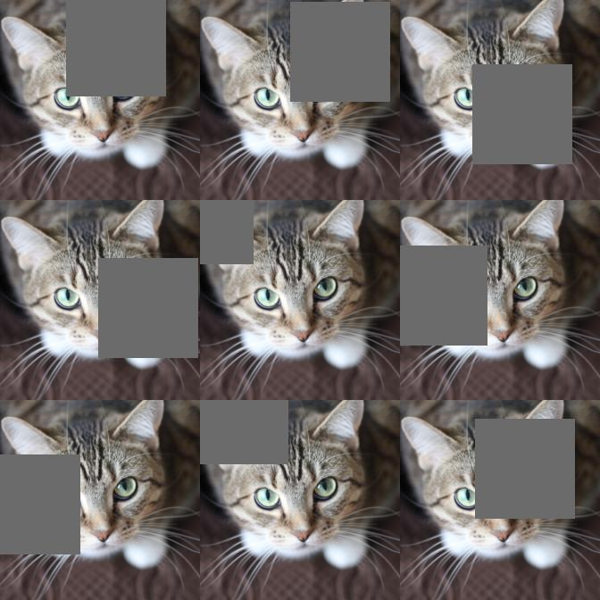
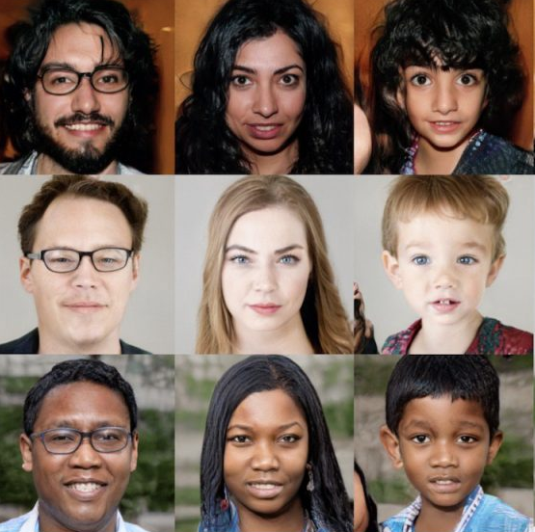
INTRODUCTION
Data augmentation
Image manipulation
Image erasing
Deep Generative models

Slide 6
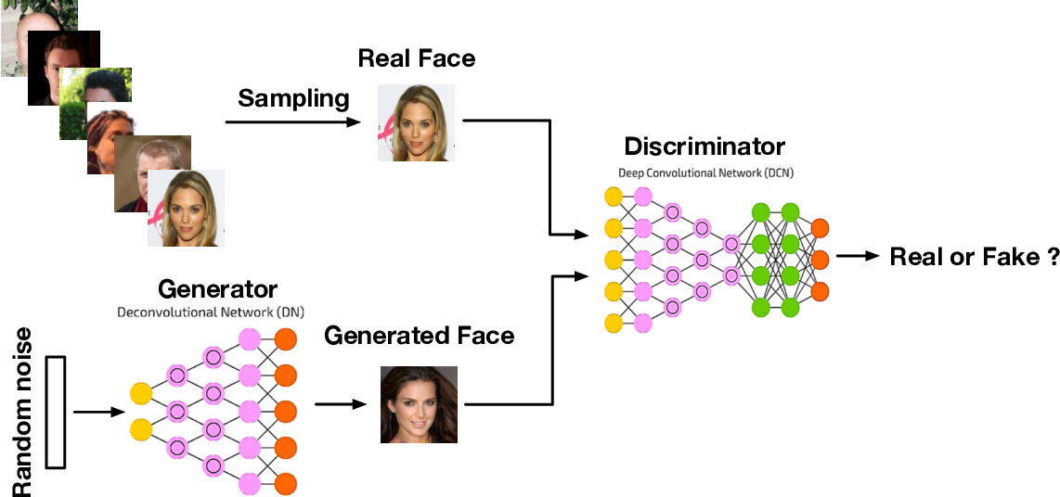
INTRODUCTION
Generative Adversarial Networks (GAN)

Slide 7
INTRODUCTION
Image-to-Image Translation
Aims to transfer images from a source domain to a target one while preserving the content representations.
It can be performed exploiting GANs with the input being an image instead of random noise.
GAN-BASED
IMAGE-TO-IMAGE TRANSLATION
TRADITIONAL GAN
Random noise
Image of source domain
GAN
GAN
Generated image
Image of target domain

Slide 8
INTRODUCTION
Image-to-Image Translation
Aims to transfer images from a source domain to a target one while preserving the content representations.
It can be performed exploiting GANs with the input being an image instead of random noise.

